Slide 1
Chapter 13
Graphics
Part II

Slide 2
Homework
Read chapters 15 and 16 for next week
- Abstract classes and interfaces
- Event-driven programming

Slide 3
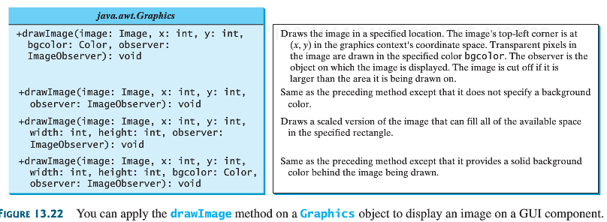
drawImage
ImageObserver receives notifications if there are changes in an image

Slide 4
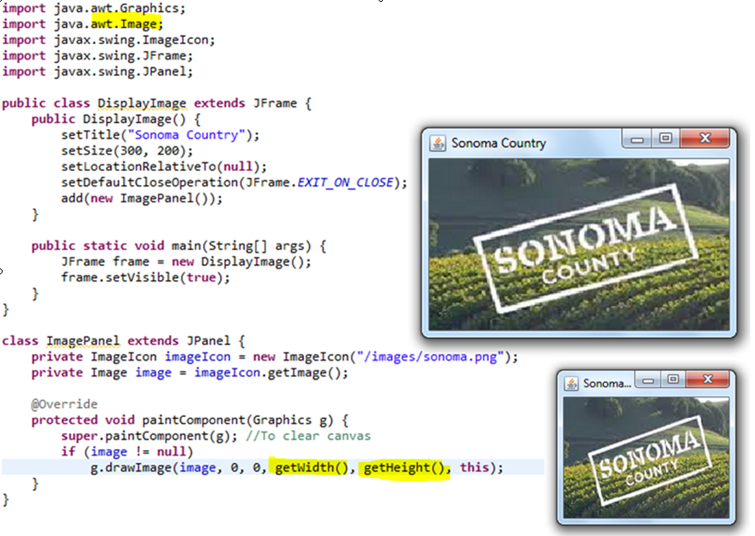
Scalable image size

Slide 5
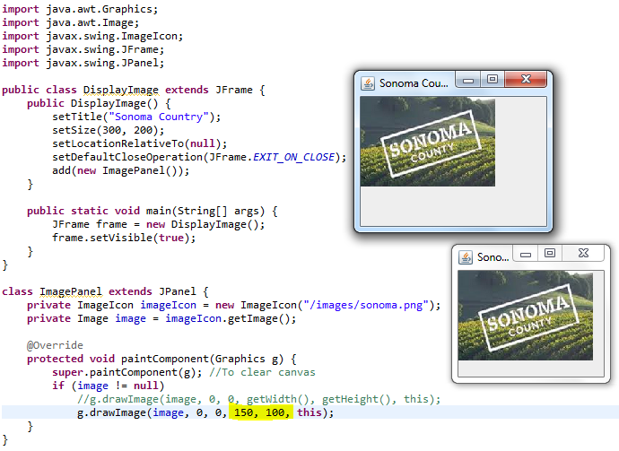
Scaled to a fixed rectangle size (width = 150; height = 100 below)

Slide 6
Exercise – 10 point
Draw an image of fixed sized as in the previous slide, however, center the image as the window size is changed
Drag the corner of your window to resize and observe the centering of the image

Slide 7
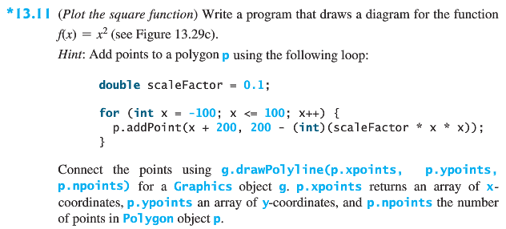
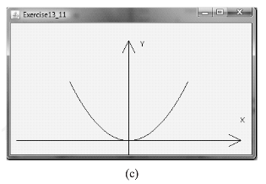
Exercise (20 points)

Slide 8
Extra Credits
Pick any programming exercise for extra credits
  Each question without any asterisk is worth 3 points
  Each asterisk next to the exercise doubles the extra credits

